Slide 1
Improving the Runtime of the Ising Model
By Brian Hanley

Slide 2
What is the Ising Model?
Models phase transitions in 1 and 2 dimensions
Consists of lattice of spin up and down particles
Particles can change spin during the simulation
System has 4 temperature dependent values
Energy per particle (E)
Specific Heat (Cv)
Mean Magnetization (|M|)
Magnetic Susceptibilty (χ)
At the critical temperature (Tc) the phase change occurs

Slide 3
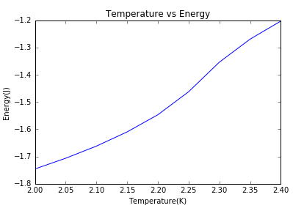
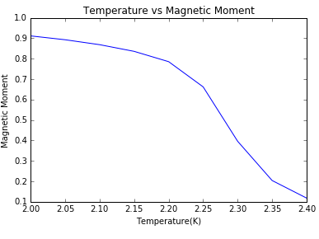
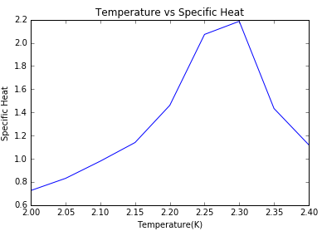
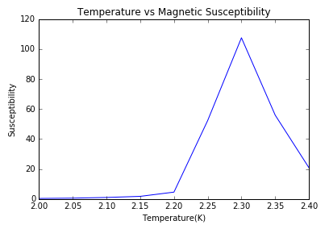

Slide 4
Methods for Ising Model
Set square matrix size, n, n * n=N
Set initial and final temperatures
Set temperature step size
Set number of Monte Carlo cycles, MC
Run tests from initial to final temperatures

Slide 5
Methods for Ising Model (cont)
Initialize Matrix and values for Energy and Magnetization
If temperature is below 1.5 all matrix spins =1, else keep old configuration
Energy: Negative sum of all points times the previous points in x and y direction
Magnetization: Sum of all the spins
Run Metropolis algorithm MC number of times, updating Energy and Magnetization as you go
At the end of each cycle update the average values E, E^2, M, M^2, and |M|

Slide 6
Methods for Ising Model (cont.)
After each temperature calculate system properties
Norm of values: Average values/MC
E and M variance: Sum of the squared values – sum of single variables squared /N
Energy per particle: Norm of E / N
Specific Heat: E variance / temperature squared
Magnetic Susceptibility: M variance / temperature
Magnetization: Norm of Absolute Magnetization / N
Plot expectation values as a function of temperature

Slide 7

Metropolis Algorithm For Ising Model
Monte Carlo Method
2 probability functions
Transition Probability: 1 in this case
Acceptance Probability: $e^{−∆E/T}$
Choose N number of random points
On accepted switches update Magnetization and Energy

Slide 8
Finding the Critical temperature
I set up a test to find the critical temperature of a system by graphing the 4 expectation values with respect to temperature
I went from T=2.0 to 2.4 at steps of 0.05
I looked at matrix sizes of 20, 40, 60, and 80
For each matrix I looked at the peaks of the Specific Heat and Magnetic Susceptibility to determine the critical temperature

Slide 9
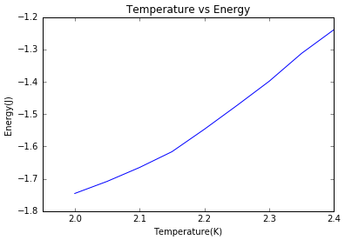
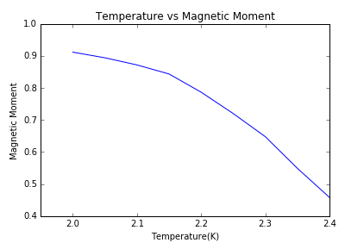
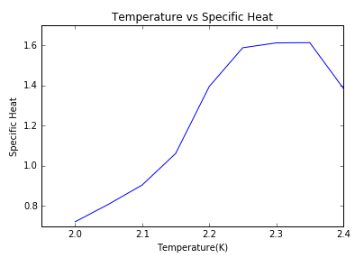
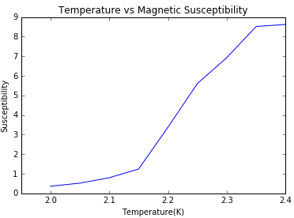
20x20 matrix

Slide 10
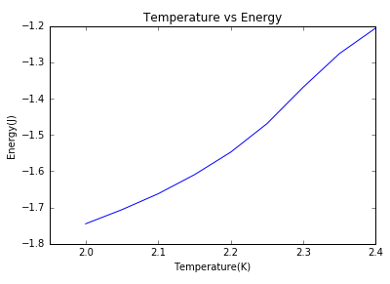
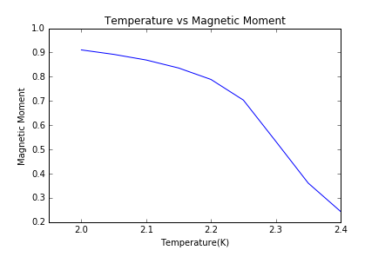
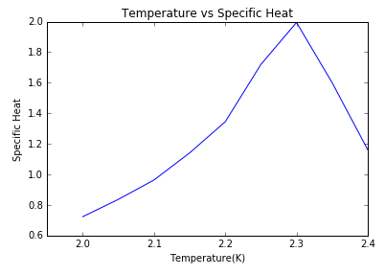
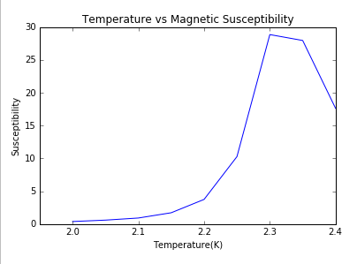
40x40 Matrix

Slide 11
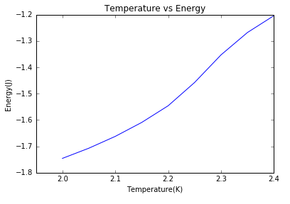
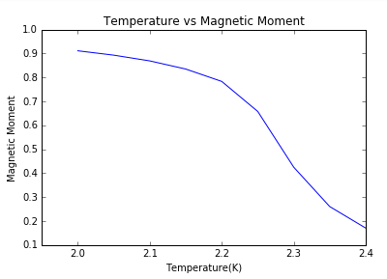
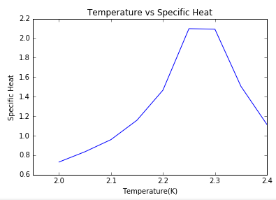
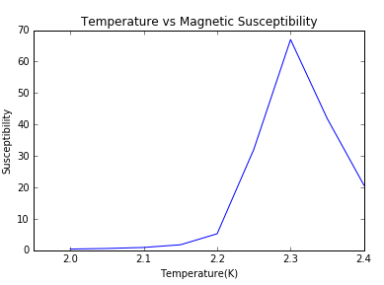
60x60 Matrix

Slide 12
80x80

Slide 13
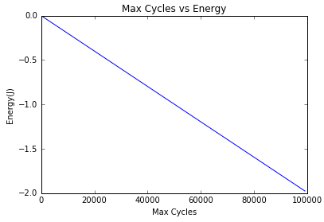
Constraints of Computing
Getting an accurate measurement of the system requires a large number of cycles
For a 2x2 matrix at temperature 1 the energy is expected to be ~-1.5244. Our methods required close to 75000 runs to reach this.
For the model to be close to useful real world applications we need to be on the scale of Avogadro's Number, ~6*10^23
To find the critical temperature accurately we need to look at a lot of temperature steps
For an 80x80 matrix at 100,000 Monte Carlo simulations looking at 8 different temperatures the Ising Model took ~11 hours.
2x2 matrix at T=1.0
Energy vs. Max Cycles

Slide 14
Possible Solutions
Cutting down on floating point operations
Using Cython to translate into C or rewriting in another language can increase efficiency
Running each temperature step concurrently could cut down on the over all time it takes to gather data

Slide 15
Parallel Processing
The processes don’t take up much processing power or memory
The starting state of the matrix has little effect on the end result of the Metropolis algorithm for a given temperature step

Slide 16
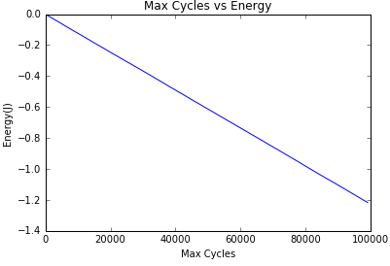
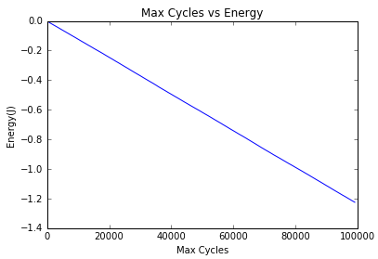
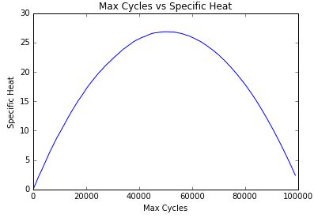
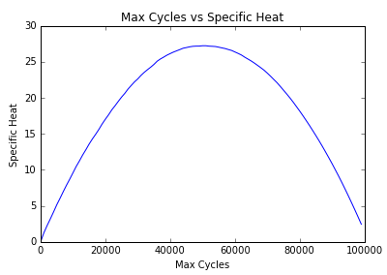
20x20 matrix, T=2.4, Homogenous Starting Matrix
20x20 matrix, T=2.4, Random Starting Matrix

Slide 17
Parallel Processing
The processes don’t take up much processing power or memory
The starting state of the matrix has little effect on the end result of the Metropolis algorithm for a given temperature step
One temperature step only takes about an hour to run individually
With more processing power we can run a whole range of temperatures in just an hour

Slide 18
Using a Lower level language
Using the Cython package in a Jupyter Notebook on the MSU engineering Jupyter Hub server.
Running an 80x80 matrix at 100000 cycles from T=2.0-2.4 at steps of 0.05
Run time cut down from 11 hours to 7 hours

Slide 19
Final Conclusion
Running each temperature step concurrently using C, Cython, or a similar language will improve the final run time of our program
Running more tests at smaller steps will give us a clearer idea of what the critical temperature will be
With an efficient program we can calculate the critical temperature for a realistically sized matrix

